Slide 1
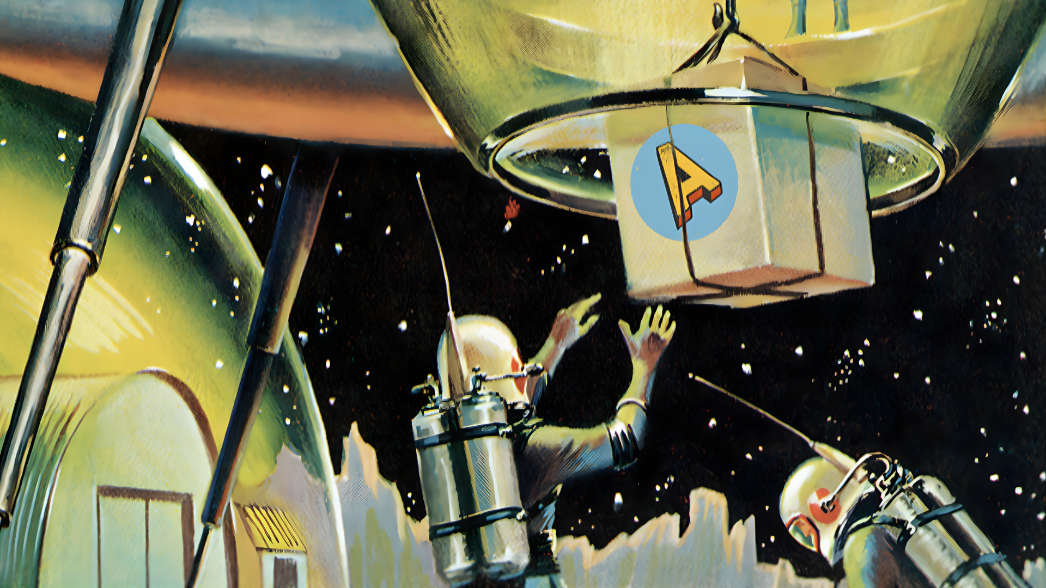
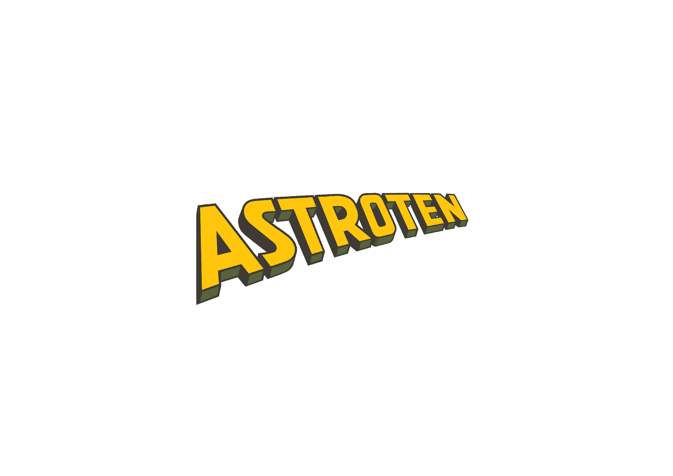
Half-informed and Fully Confident:
The Behavioural Science Behind Uninformed Experts
Richard Shotton
The Choice Factory | The Illusion of Choice
@rshotton

Slide 2
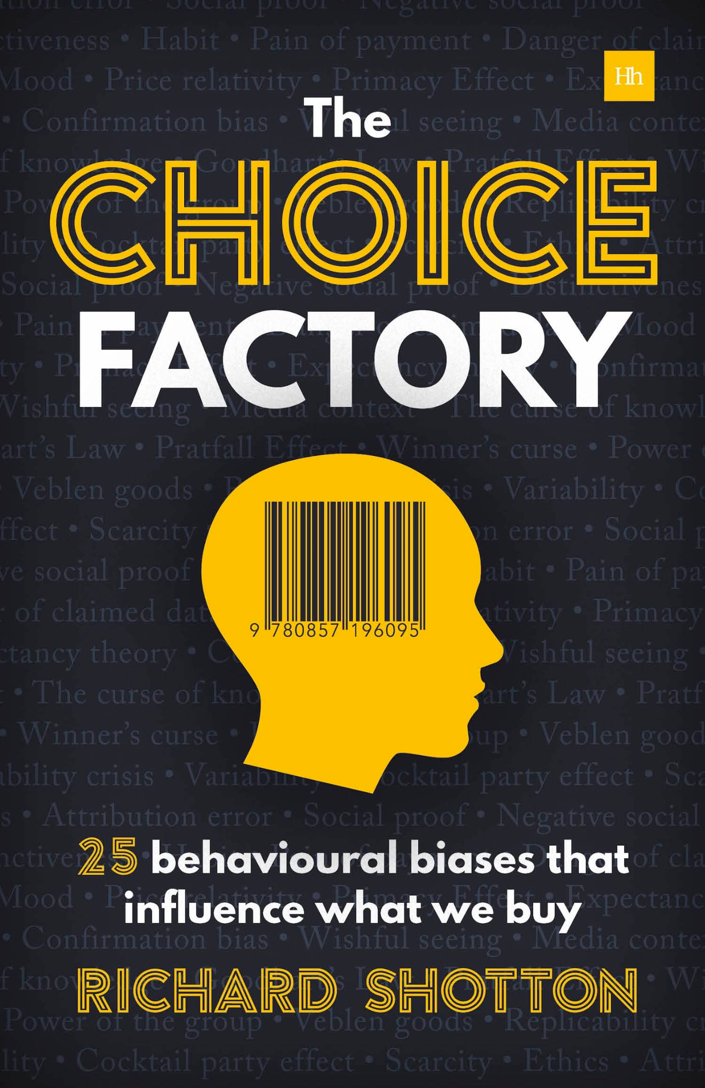
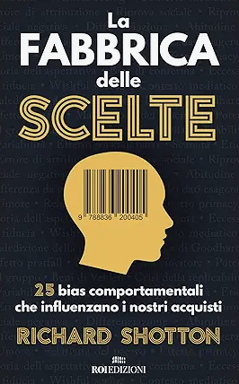

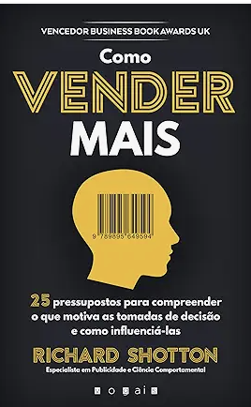
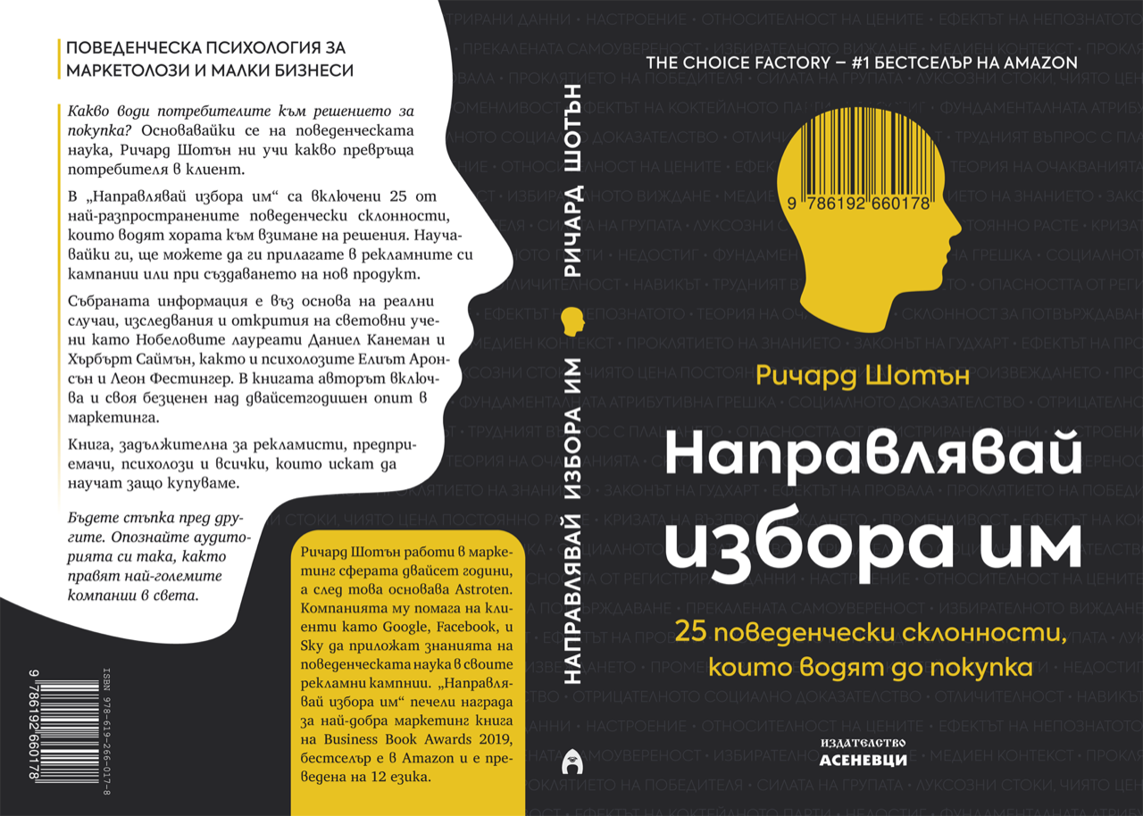
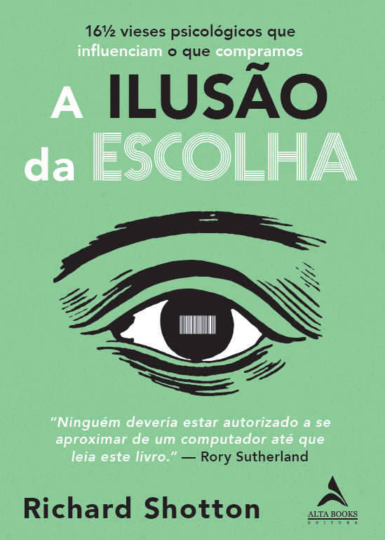
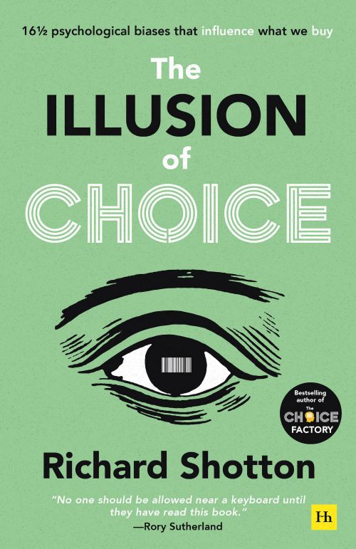
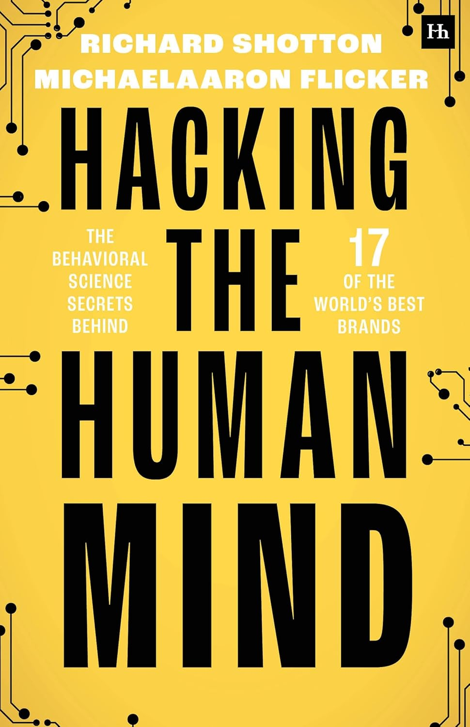

Slide 3
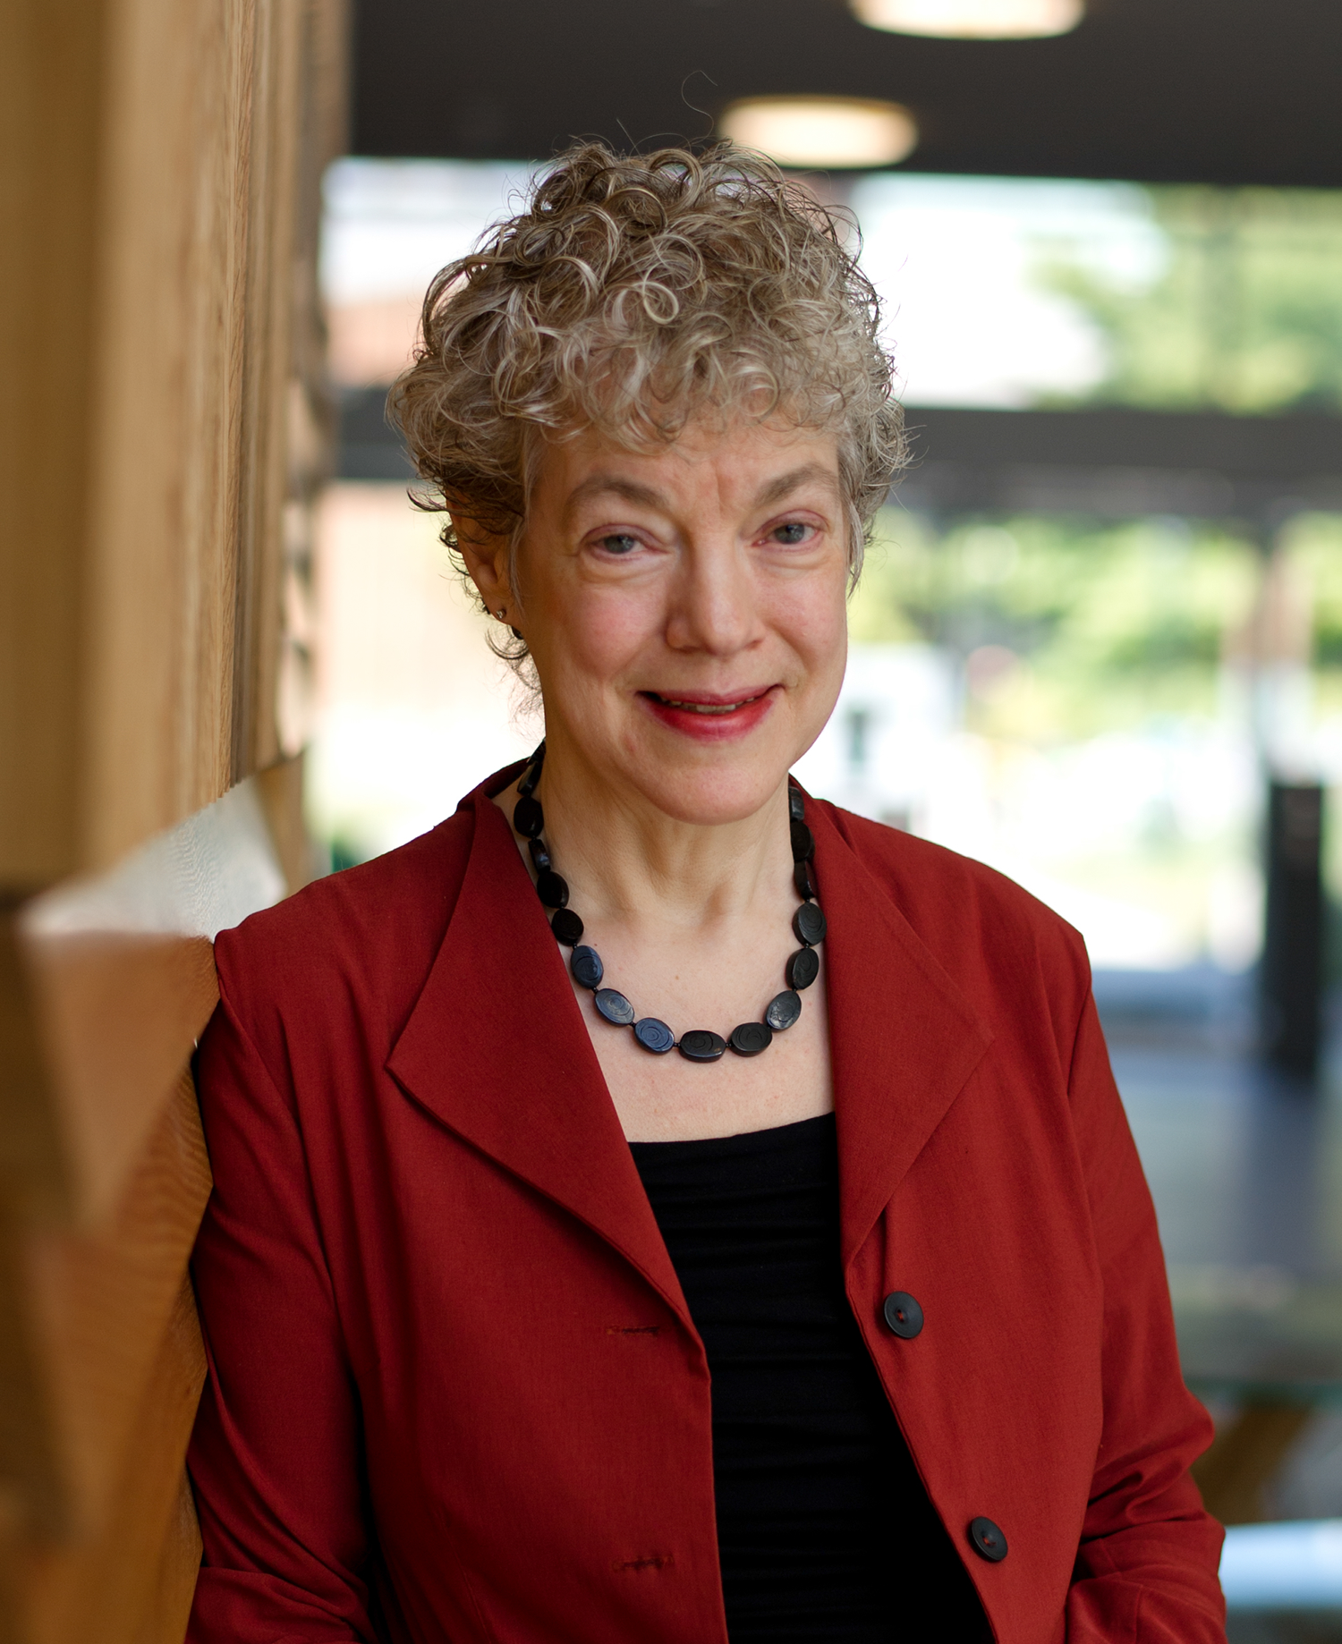
Notes:
Susan Fiske - “We are cognitive misers”

Slide 4
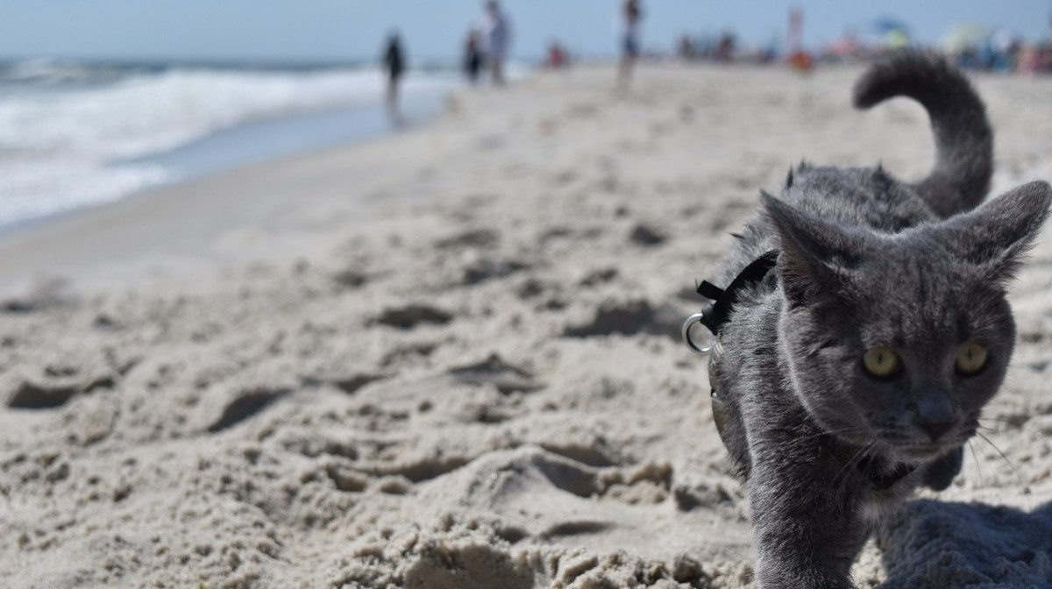
“Thinking is to humans as swimming is to cats;

Slide 5
“Thinking is to humans as swimming is to cats; they can do it but they’d prefer
not to” - Daniel Kahneman

Slide 6
What Makes Uninformed Experts Influential?
@rshotton

Slide 7
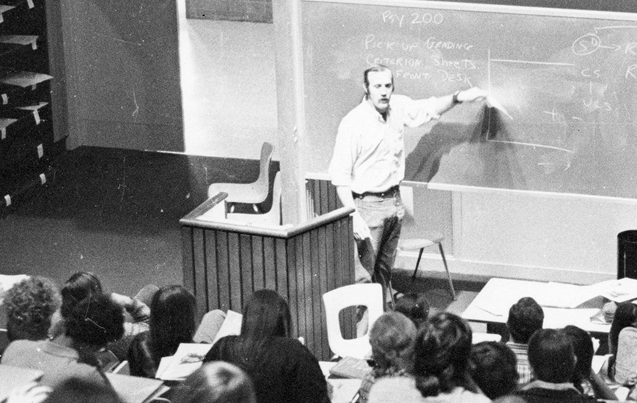
Notes:
Halo Effect
The halo effect is the tendency for the dominant attribute of a person or brand to influence people’s opinions of their attributes in other areas.
Evidence: Richard Nisbett, from the University of Michigan, and Timothy Wilson, from the University of Virginia, conducted a study in 1977 into the halo effect.
They randomly assigned students to one of two groups and asked them to watch a video of a foreign instructor with a noticeable accent. In one video, the instructor presented himself as someone warm and likeable. In the other, he presented himself as cold and unlikable. His mannerisms and accent were kept the same in both versions of the videos.
Students were then asked to rate the instructor on his likeability but also on criteria unrelated to his warmth: his physical appearance, mannerisms and accent (from extremely appealing to extremely irritating). The subjects who saw the warm instructor rated his appearance, mannerisms, and accent as appealing, whereas those who saw the cold instructor rated these attributes as irritating:
Appearance: 70% vs 38%
Mannerisms: 60% vs 40%
Accent: 50% vs 27%

Slide 8
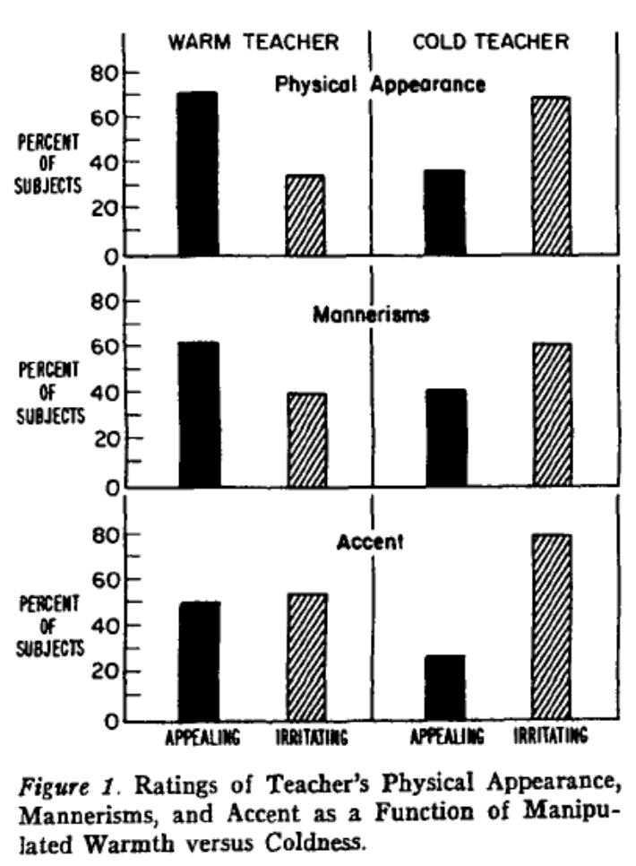
Source: Nisbett & Wilson (1977)
Notes:
Halo Effect
The halo effect is the tendency for the dominant attribute of a person or brand to influence people’s opinions of their attributes in other areas.
Evidence: Richard Nisbett, from the University of Michigan, and Timothy Wilson, from the University of Virginia, conducted a study in 1977 into the halo effect.
They randomly assigned students to one of two groups and asked them to watch a video of a foreign instructor with a noticeable accent. In one video, the instructor presented himself as someone warm and likeable. In the other, he presented himself as cold and unlikable. His mannerisms and accent were kept the same in both versions of the videos.
Students were then asked to rate the instructor on his likeability but also on criteria unrelated to his warmth: his physical appearance, mannerisms and accent (from extremely appealing to extremely irritating). The subjects who saw the warm instructor rated his appearance, mannerisms, and accent as appealing, whereas those who saw the cold instructor rated these attributes as irritating:
Appearance: 70% vs 38%
Mannerisms: 60% vs 40%
Accent: 50% vs 27%

Slide 9
38
40
27
Source: Nisbett & Wilson (1977)
Notes:
Halo Effect
The halo effect is the tendency for the dominant attribute of a person or brand to influence people’s opinions of their attributes in other areas.
Evidence: Richard Nisbett, from the University of Michigan, and Timothy Wilson, from the University of Virginia, conducted a study in 1977 into the halo effect.
They randomly assigned students to one of two groups and asked them to watch a video of a foreign instructor with a noticeable accent. In one video, the instructor presented himself as someone warm and likeable. In the other, he presented himself as cold and unlikable. His mannerisms and accent were kept the same in both versions of the videos.
Students were then asked to rate the instructor on his likeability but also on criteria unrelated to his warmth: his physical appearance, mannerisms and accent (from extremely appealing to extremely irritating). The subjects who saw the warm instructor rated his appearance, mannerisms, and accent as appealing, whereas those who saw the cold instructor rated these attributes as irritating:
Appearance: 70% vs 38%
Mannerisms: 60% vs 40%
Accent: 50% vs 27%

Slide 10
70
38
+84%
61
40
+50%
49
27
+85%
Source: Nisbett & Wilson (1977)
Notes:
Halo Effect
The halo effect is the tendency for the dominant attribute of a person or brand to influence people’s opinions of their attributes in other areas.
Evidence: Richard Nisbett, from the University of Michigan, and Timothy Wilson, from the University of Virginia, conducted a study in 1977 into the halo effect.
They randomly assigned students to one of two groups and asked them to watch a video of a foreign instructor with a noticeable accent. In one video, the instructor presented himself as someone warm and likeable. In the other, he presented himself as cold and unlikable. His mannerisms and accent were kept the same in both versions of the videos.
Students were then asked to rate the instructor on his likeability but also on criteria unrelated to his warmth: his physical appearance, mannerisms and accent (from extremely appealing to extremely irritating). The subjects who saw the warm instructor rated his appearance, mannerisms, and accent as appealing, whereas those who saw the cold instructor rated these attributes as irritating:
Appearance: 70% vs 38%
Mannerisms: 60% vs 40%
Accent: 50% vs 27%

Slide 11
Source: McGlone and Tofighbakhsh (1999)
List A (Non-rhyming)
What sobriety conceals, alcohol unmasks
Children and fools shouldn’t play with sharp objects
Woes unite enemies
Variation prevents satiety
Caution and measure will win you riches
Notes:
Rhyme as Reason
The “Rhyme as Reason” principe suggests that people are more likely to remember rhyming phrases more than non-rhyming ones. This occurs due to a combination of the aesthetic qualities of words that rhyme (i.e. they sound nice) and high processing fluency (they’re easy for our brains to digest).
Evidence: In 1999, psychologists Matthew McGlone and Jessica Tofighbakhsh from Lafayette College, Pennsylvania, investigated the influence of rhyme on the believability of proverbs.
Participants were split into two groups. One was given a list or proverbs in a rhyming form and others were given a list where the items were modified to not rhyme, for example “woes unite foes” vs “woes unite enemies”. The participant’s task was to rate the believability of the proverbs.
The findings indicated that the rhyming statements were perceived to be 17% more accurate than their non-rhyming alternatives.
The authors claimed that this is because people rely on a rule of thumb, whereby the aesthetic qualities of a message reflect its truth.

Slide 12
Source: McGlone and Tofighbakhsh (1999)
List A (Non-rhyming)
What sobriety conceals, alcohol unmasks
Children and fools shouldn’t play with sharp objects
Woes unite enemies
Variation prevents satiety
Caution and measure will win you riches
List B (Rhyming)
What sobriety conceals, alcohol reveals
Children and fools shouldn’t play with sharp tools
Woes unite foes
Variety prevents satiety
Caution and measure will win you treasure
Notes:
Rhyme as Reason
The “Rhyme as Reason” principe suggests that people are more likely to remember rhyming phrases more than non-rhyming ones. This occurs due to a combination of the aesthetic qualities of words that rhyme (i.e. they sound nice) and high processing fluency (they’re easy for our brains to digest).
Evidence: In 1999, psychologists Matthew McGlone and Jessica Tofighbakhsh from Lafayette College, Pennsylvania, investigated the influence of rhyme on the believability of proverbs.
Participants were split into two groups. One was given a list or proverbs in a rhyming form and others were given a list where the items were modified to not rhyme, for example “woes unite foes” vs “woes unite enemies”. The participant’s task was to rate the believability of the proverbs.
The findings indicated that the rhyming statements were perceived to be 17% more accurate than their non-rhyming alternatives.
The authors claimed that this is because people rely on a rule of thumb, whereby the aesthetic qualities of a message reflect its truth.

Slide 13
Source: McGlone and Tofighbakhsh (1999)
List A (Non-rhyming)
What sobriety conceals, alcohol unmasks
Children and fools shouldn’t play with sharp objects
Woes unite enemies
Variation prevents satiety
Caution and measure will win you riches
List B (Rhyming)
What sobriety conceals, alcohol reveals
Children and fools shouldn’t play with sharp tools
Woes unite foes
Variety prevents satiety
Caution and measure will win you treasure
+17% accuracy
Notes:
Rhyme as Reason
The “Rhyme as Reason” principe suggests that people are more likely to remember rhyming phrases more than non-rhyming ones. This occurs due to a combination of the aesthetic qualities of words that rhyme (i.e. they sound nice) and high processing fluency (they’re easy for our brains to digest).
Evidence: In 1999, psychologists Matthew McGlone and Jessica Tofighbakhsh from Lafayette College, Pennsylvania, investigated the influence of rhyme on the believability of proverbs.
Participants were split into two groups. One was given a list or proverbs in a rhyming form and others were given a list where the items were modified to not rhyme, for example “woes unite foes” vs “woes unite enemies”. The participant’s task was to rate the believability of the proverbs.
The findings indicated that the rhyming statements were perceived to be 17% more accurate than their non-rhyming alternatives.
The authors claimed that this is because people rely on a rule of thumb, whereby the aesthetic qualities of a message reflect its truth.

Slide 14
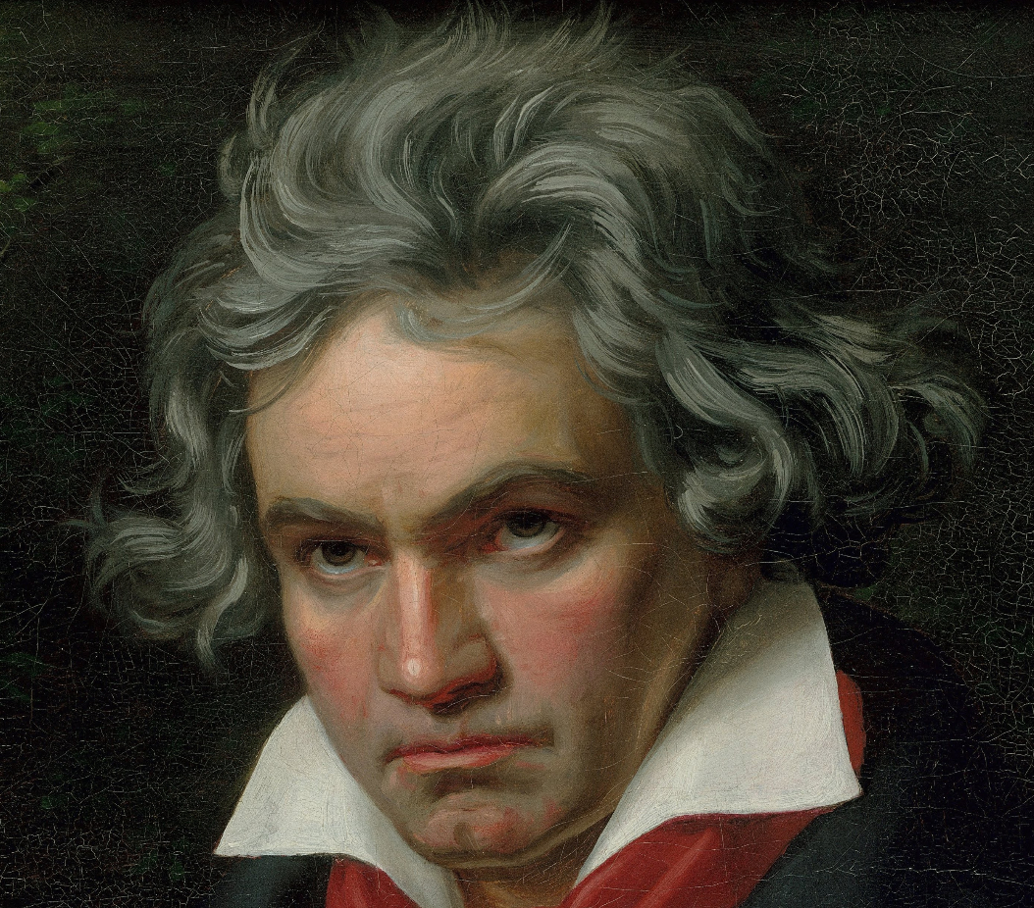
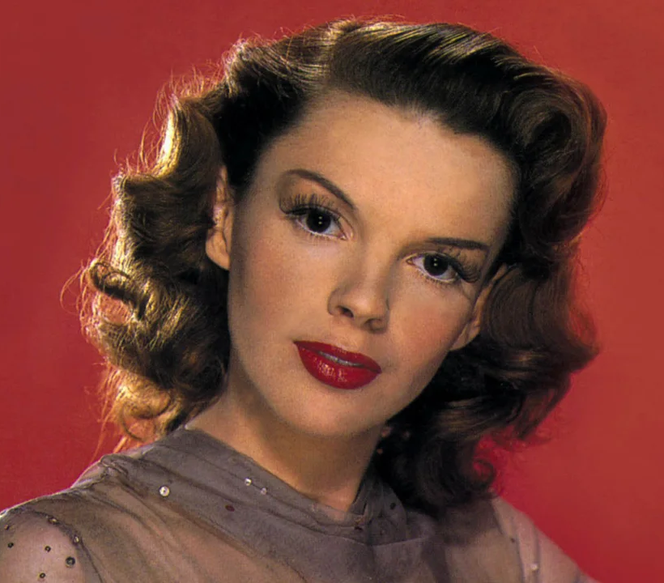
“Ludwig van Beethoven was a lifelong bachelor”
(true)
“Judy Garland’s real name was Louise Hovick”
(false)
Source: Schwartz (1982)
Notes:
Illusory Truth Effect
We have a tendency to believe things, merely because we are familiar with them.
Evidence: In 1982, psychology professor Marian Schwartz from the University of Wisconsin, showed participants a selection of true and false statements. For example:
“Ludwig van Beethoven was a lifelong bachelor” (true)
“Judy Garland’s real name was Louise Hovick” (false)
However, some participants were shown some of the statements once or three times before.
All participants were asked to judge whether the statements were true on a scale from 1-7 (where 1 = “Definitely no” and 7 = “Definitely yes”).
Participants who saw the statements for the first time gave a rating of 3.92. Participants who saw the statements once before gave a rating of 4.20 - a roughly 7% uplift compared to the control. Finally, participants who saw the statements three times before gave a rating of 4.27 - a 9% increase compared to the control.

Slide 15
# of times people saw statements | Truth rating
One
Three
1 = definitely not true
7 = definitely true
Source: Schwartz (1982)
Notes:
Illusory Truth Effect
We have a tendency to believe things, merely because we are familiar with them.
Evidence: In 1982, psychology professor Marian Schwartz from the University of Wisconsin, showed participants a selection of true and false statements. For example:
“Ludwig van Beethoven was a lifelong bachelor” (true)
“Judy Garland’s real name was Louise Hovick” (false)
However, some participants were shown some of the statements once or three times before.
All participants were asked to judge whether the statements were true on a scale from 1-7 (where 1 = “Definitely no” and 7 = “Definitely yes”).
Participants who saw the statements for the first time gave a rating of 3.92. Participants who saw the statements once before gave a rating of 4.20 - a roughly 7% uplift compared to the control. Finally, participants who saw the statements three times before gave a rating of 4.27 - a 9% increase compared to the control.

Slide 16
# of times people saw statements | Truth rating
One | 3.92
Three
1 = definitely not true
7 = definitely true
Source: Schwartz (1982)
Notes:
Illusory Truth Effect
We have a tendency to believe things, merely because we are familiar with them.
Evidence: In 1982, psychology professor Marian Schwartz from the University of Wisconsin, showed participants a selection of true and false statements. For example:
“Ludwig van Beethoven was a lifelong bachelor” (true)
“Judy Garland’s real name was Louise Hovick” (false)
However, some participants were shown some of the statements once or three times before.
All participants were asked to judge whether the statements were true on a scale from 1-7 (where 1 = “Definitely no” and 7 = “Definitely yes”).
Participants who saw the statements for the first time gave a rating of 3.92. Participants who saw the statements once before gave a rating of 4.20 - a roughly 7% uplift compared to the control. Finally, participants who saw the statements three times before gave a rating of 4.27 - a 9% increase compared to the control.

Slide 17
# of times people saw statements | Truth rating
One | 3.92
Three | 4.27
1 = definitely not true
7 = definitely true
Source: Schwartz (1982)
Notes:
Illusory Truth Effect
We have a tendency to believe things, merely because we are familiar with them.
Evidence: In 1982, psychology professor Marian Schwartz from the University of Wisconsin, showed participants a selection of true and false statements. For example:
“Ludwig van Beethoven was a lifelong bachelor” (true)
“Judy Garland’s real name was Louise Hovick” (false)
However, some participants were shown some of the statements once or three times before.
All participants were asked to judge whether the statements were true on a scale from 1-7 (where 1 = “Definitely no” and 7 = “Definitely yes”).
Participants who saw the statements for the first time gave a rating of 3.92. Participants who saw the statements once before gave a rating of 4.20 - a roughly 7% uplift compared to the control. Finally, participants who saw the statements three times before gave a rating of 4.27 - a 9% increase compared to the control.

Slide 18
# of times people saw statements | Truth rating
One | 3.92
Three | 4.27
+9% believability
1 = definitely not true
7 = definitely true
Source: Schwartz (1982)
Notes:
Illusory Truth Effect
We have a tendency to believe things, merely because we are familiar with them.
Evidence: In 1982, psychology professor Marian Schwartz from the University of Wisconsin, showed participants a selection of true and false statements. For example:
“Ludwig van Beethoven was a lifelong bachelor” (true)
“Judy Garland’s real name was Louise Hovick” (false)
However, some participants were shown some of the statements once or three times before.
All participants were asked to judge whether the statements were true on a scale from 1-7 (where 1 = “Definitely no” and 7 = “Definitely yes”).
Participants who saw the statements for the first time gave a rating of 3.92. Participants who saw the statements once before gave a rating of 4.20 - a roughly 7% uplift compared to the control. Finally, participants who saw the statements three times before gave a rating of 4.27 - a 9% increase compared to the control.

Slide 19
How Can Brands Boost Trust?
@rshotton

Slide 20
Source | % of participants who accepted the free health scan
External Investigation
Company
Source: Fennis and Strobe (2014)
Notes:
Stolen Thunder Effect
Brands can reduce the impact of negative information by admitting to it publicly. This is called the stolen thunder effect.
Evidence: In 2014, Bob Fennis from the University of Groningen and Wolfgang Strobe from Utrecht University ran a study into the stolen thunder effect.
They showed participants an article about a fictional pharmaceutical company called AescuMed. The article explained that one of the company’s drugs had a significant side effect.
However, for some participants, the article said that this issue had been uncovered by an external investigation. For others, it said that the company itself had disclosed the problem.
Next, everyone was offered a free health scan from AescuMed.
The researchers found that when information about the side effect came from a third-party, 13% accepted the free health scan. But when the information came directly from the company. 59% signed up for the health scan - a more than 4.5x uplift.

Slide 21
Source | % of participants who accepted the free health scan
External Investigation | 13%
Company
Source: Fennis and Strobe (2014)
Notes:
Stolen Thunder Effect
Brands can reduce the impact of negative information by admitting to it publicly. This is called the stolen thunder effect.
Evidence: In 2014, Bob Fennis from the University of Groningen and Wolfgang Strobe from Utrecht University ran a study into the stolen thunder effect.
They showed participants an article about a fictional pharmaceutical company called AescuMed. The article explained that one of the company’s drugs had a significant side effect.
However, for some participants, the article said that this issue had been uncovered by an external investigation. For others, it said that the company itself had disclosed the problem.
Next, everyone was offered a free health scan from AescuMed.
The researchers found that when information about the side effect came from a third-party, 13% accepted the free health scan. But when the information came directly from the company. 59% signed up for the health scan - a more than 4.5x uplift.

Slide 22
Source | % of participants who accepted the free health scan
External Investigation | 13%
Company | 59%
Source: Fennis and Strobe (2014)
Notes:
Stolen Thunder Effect
Brands can reduce the impact of negative information by admitting to it publicly. This is called the stolen thunder effect.
Evidence: In 2014, Bob Fennis from the University of Groningen and Wolfgang Strobe from Utrecht University ran a study into the stolen thunder effect.
They showed participants an article about a fictional pharmaceutical company called AescuMed. The article explained that one of the company’s drugs had a significant side effect.
However, for some participants, the article said that this issue had been uncovered by an external investigation. For others, it said that the company itself had disclosed the problem.
Next, everyone was offered a free health scan from AescuMed.
The researchers found that when information about the side effect came from a third-party, 13% accepted the free health scan. But when the information came directly from the company. 59% signed up for the health scan - a more than 4.5x uplift.

Slide 23
Source | % of participants who accepted the free health scan
External Investigation | 13%
Company | 59%
4.5x
Source: Fennis and Strobe (2014)
Notes:
Stolen Thunder Effect
Brands can reduce the impact of negative information by admitting to it publicly. This is called the stolen thunder effect.
Evidence: In 2014, Bob Fennis from the University of Groningen and Wolfgang Strobe from Utrecht University ran a study into the stolen thunder effect.
They showed participants an article about a fictional pharmaceutical company called AescuMed. The article explained that one of the company’s drugs had a significant side effect.
However, for some participants, the article said that this issue had been uncovered by an external investigation. For others, it said that the company itself had disclosed the problem.
Next, everyone was offered a free health scan from AescuMed.
The researchers found that when information about the side effect came from a third-party, 13% accepted the free health scan. But when the information came directly from the company. 59% signed up for the health scan - a more than 4.5x uplift.

Slide 24
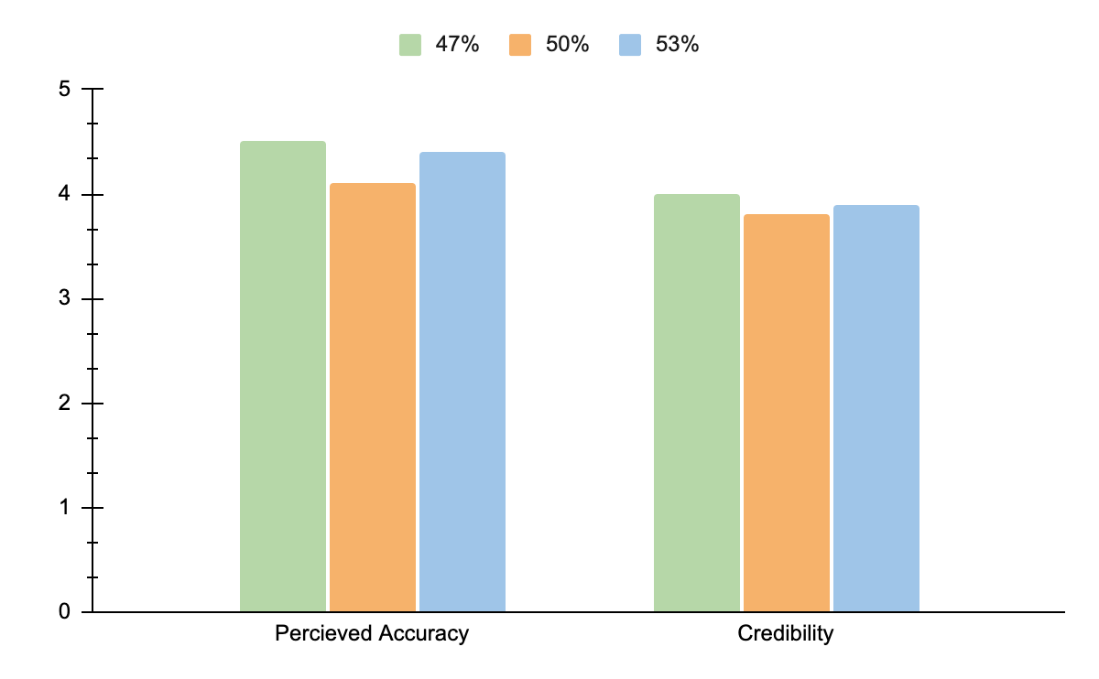
Adapted from Schindler & Yalch (2006)
Notes:
Precision
Rounded numbers are often treated with scepticism, as individuals tend to assume they have been rounded up more. In contrast, precise numbers are more believable.
Example: In 2006, Robert Schindler from Rutgers University and Richard Yalch from the University of Washington conducted a study into the effect of round versus precise numbers on the accuracy and credibility of advertising claims.
Participants were shown a fictitious body spray, with three varying numerical claims: “Lasts [47%, 50%, or 53%] longer than any other deodorant”. Participants were then asked to indicate credibility (more true, more believable, more trustworthy and more convincing) and accuracy of the claim (more accurate, more exaggerated, based on actual scientific evidence and better documented).
Precise claims (47% and 53%) were judged to be more accurate than round claims (50%). Credibility ratings were slightly higher for precise than for rounded claims, but this effect was not statistically significant.

Slide 25
Adapted from Schindler & Yalch (2006)
Notes:
Precision
Rounded numbers are often treated with scepticism, as individuals tend to assume they have been rounded up more. In contrast, precise numbers are more believable.
Example: In 2006, Robert Schindler from Rutgers University and Richard Yalch from the University of Washington conducted a study into the effect of round versus precise numbers on the accuracy and credibility of advertising claims.
Participants were shown a fictitious body spray, with three varying numerical claims: “Lasts [47%, 50%, or 53%] longer than any other deodorant”. Participants were then asked to indicate credibility (more true, more believable, more trustworthy and more convincing) and accuracy of the claim (more accurate, more exaggerated, based on actual scientific evidence and better documented).
Precise claims (47% and 53%) were judged to be more accurate than round claims (50%). Credibility ratings were slightly higher for precise than for rounded claims, but this effect was not statistically significant.

Slide 26
Adapted from Schindler & Yalch (2006)
Notes:
Precision
Rounded numbers are often treated with scepticism, as individuals tend to assume they have been rounded up more. In contrast, precise numbers are more believable.
Example: In 2006, Robert Schindler from Rutgers University and Richard Yalch from the University of Washington conducted a study into the effect of round versus precise numbers on the accuracy and credibility of advertising claims.
Participants were shown a fictitious body spray, with three varying numerical claims: “Lasts [47%, 50%, or 53%] longer than any other deodorant”. Participants were then asked to indicate credibility (more true, more believable, more trustworthy and more convincing) and accuracy of the claim (more accurate, more exaggerated, based on actual scientific evidence and better documented).
Precise claims (47% and 53%) were judged to be more accurate than round claims (50%). Credibility ratings were slightly higher for precise than for rounded claims, but this effect was not statistically significant.

Slide 27

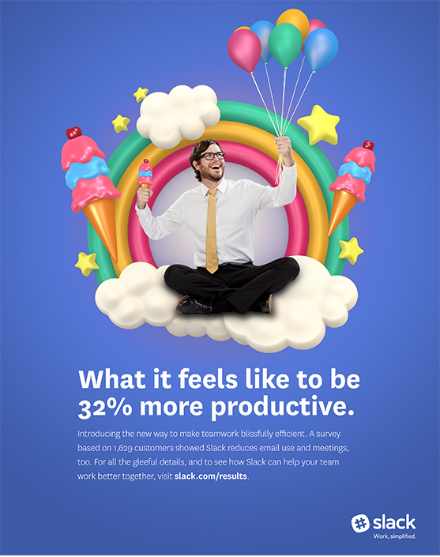
Notes:
Precision
Example: Slack

Slide 28
Notes:
Precision
Example: The Illusion of Choice

Slide 29
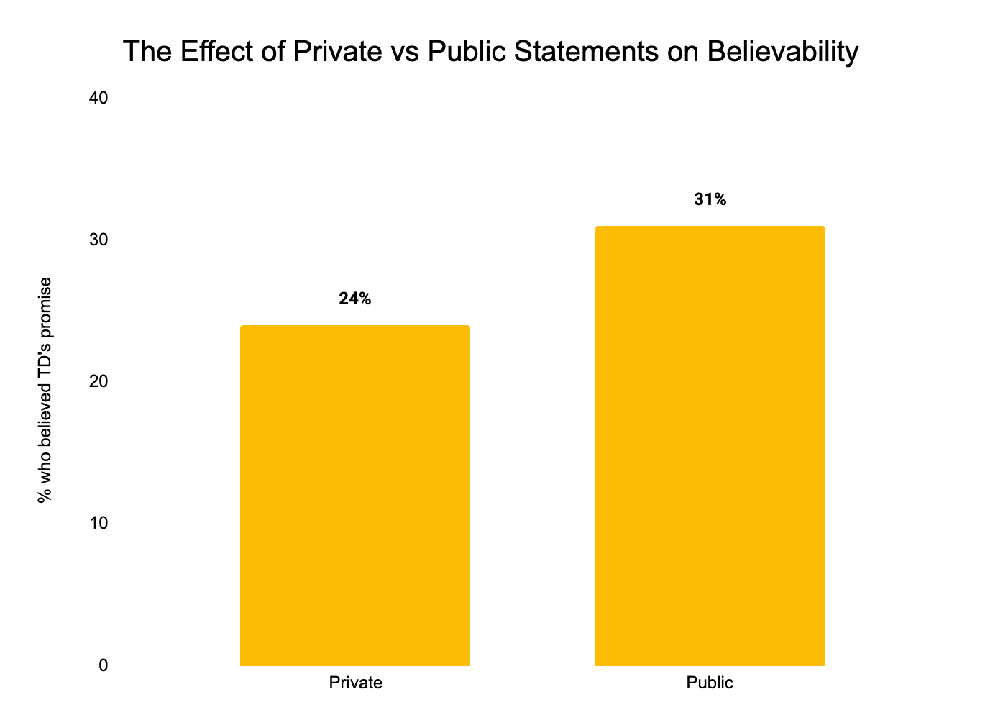
Source: Astroten, TAM, and Red C (2024)
Notes:
Public Statements
Statements made in public are much more believable than statements made in private.
Evidence: In 2024, we partnered with TAM and Red C, and asked a nationally representative sample of 2,710 adults to imagine their local TD pledging to increase spending on speed cameras by 10% in the next year.
Half of the participants were told that the pledge was made during a one-to-one conversation (private condition), while the other half were told that it was given at a public meeting (public condition). Next, participants were asked how likely the TD was to keep his promise on a scale from 1-4 (1 = ‘Not likely at all to keep this promise’; 4 = ‘Very likely to keep this promise’).
Among respondents in the private condition, 24% believed the TD’s promise (i.e. gave a rating of 3-4). However, in the public condition, 31% of participants believed the pledge - a 29% uplift.

Slide 30
24%
Source: Astroten, TAM, and Red C (2024)
Notes:
Public Statements
Statements made in public are much more believable than statements made in private.
Evidence: In 2024, we partnered with TAM and Red C, and asked a nationally representative sample of 2,710 adults to imagine their local TD pledging to increase spending on speed cameras by 10% in the next year.
Half of the participants were told that the pledge was made during a one-to-one conversation (private condition), while the other half were told that it was given at a public meeting (public condition). Next, participants were asked how likely the TD was to keep his promise on a scale from 1-4 (1 = ‘Not likely at all to keep this promise’; 4 = ‘Very likely to keep this promise’).
Among respondents in the private condition, 24% believed the TD’s promise (i.e. gave a rating of 3-4). However, in the public condition, 31% of participants believed the pledge - a 29% uplift.

Slide 31
31%
24%
Source: Astroten, TAM, and Red C (2024)
Notes:
Public Statements
Statements made in public are much more believable than statements made in private.
Evidence: In 2024, we partnered with TAM and Red C, and asked a nationally representative sample of 2,710 adults to imagine their local TD pledging to increase spending on speed cameras by 10% in the next year.
Half of the participants were told that the pledge was made during a one-to-one conversation (private condition), while the other half were told that it was given at a public meeting (public condition). Next, participants were asked how likely the TD was to keep his promise on a scale from 1-4 (1 = ‘Not likely at all to keep this promise’; 4 = ‘Very likely to keep this promise’).
Among respondents in the private condition, 24% believed the TD’s promise (i.e. gave a rating of 3-4). However, in the public condition, 31% of participants believed the pledge - a 29% uplift.

Slide 32
31%
24%
+29%
Source: Astroten, TAM, and Red C (2024)
Notes:
Public Statements
Statements made in public are much more believable than statements made in private.
Evidence: In 2024, we partnered with TAM and Red C, and asked a nationally representative sample of 2,710 adults to imagine their local TD pledging to increase spending on speed cameras by 10% in the next year.
Half of the participants were told that the pledge was made during a one-to-one conversation (private condition), while the other half were told that it was given at a public meeting (public condition). Next, participants were asked how likely the TD was to keep his promise on a scale from 1-4 (1 = ‘Not likely at all to keep this promise’; 4 = ‘Very likely to keep this promise’).
Among respondents in the private condition, 24% believed the TD’s promise (i.e. gave a rating of 3-4). However, in the public condition, 31% of participants believed the pledge - a 29% uplift.

Slide 33
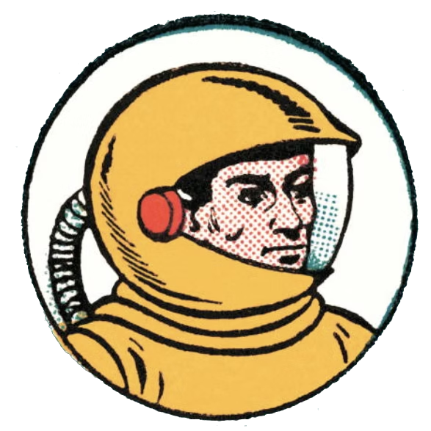
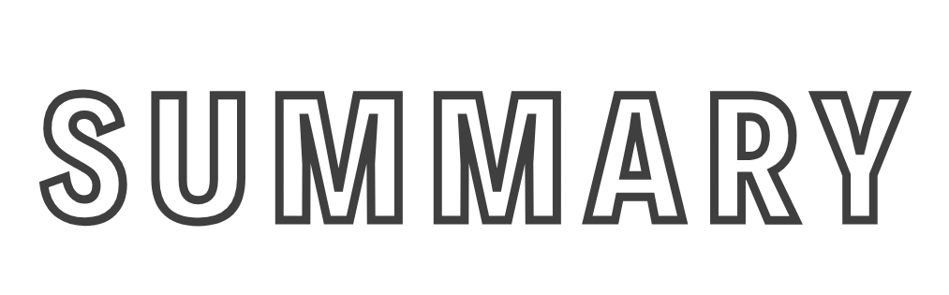
Summary
What Makes Uninformed Experts Influential?
Halo Effect: Positive traits in one area rub off on other, unrelated areas (e.g. confident = knowledgeable)
Rhyme as Reason: eloquence is often confused with truthfulness
Illusory Truth Effect: we’re more likely to believe a lie if its repeated
How Can Brands Boost Trust?
Stolen Thunder: Reduce the impact of negative information by admitting to it publicly
Precision: use precise, rather than rounded numbers
Public statements: public statements are more believable than private promises

Slide 34
Notes:
Richard’s Books
The Choice Factory: https://amzn.eu/d/06UWAeXl
The Illusion of Choice: https://amzn.eu/d/0i49OJhZ
Hacking the Human Mind: https://amzn.eu/d/047ON3vd

Slide 35
Half-informed and Fully Confident:
The Behavioural Science Behind Uninformed Experts
Richard Shotton
The Choice Factory | The Illusion of Choice
@rshotton

